Slide 1
Classification using Ensemble Learning.
AIM :- To find the best Classifier out of SVM and Decision Tree using Ensemble method.
An Ensemble prepares different models of weak learners and combine their predictions to get a stronger classifier.
Bagging.
Boosting. ( Adaboost, Gradient Boost, XGBoost ).
Stacking.
Here SVM & Decision Tree are used as weak classifiers.
Advantage
Ensemble can reduce the variance of the prediction.
The overall model will have better performance than single model.

Slide 2
Datasets Analysis
DATA | # of Patterns ( samples) | # of Features. (Attributes)
Wisconsin Breast cancer. | 683 | 11
Pima Diabetes | 786 | 10
Liver Disorder. | 345 | 8
Ten real-valued features are computed for each cell nucleus.
Attributes :- radius, texture ,perimeter, area, smoothness, compactness, concavity, concave points,symmetry , fractal dimension. ( x1, x2, x3,x4, …. )
O/P :- Diagnosis (M = malignant, B = benign) ( Y)

Slide 3

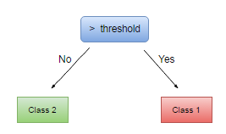
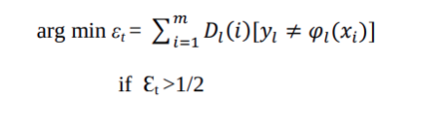
Adaboost Algorithm
With Initial weights we prepare Model 1 ( Weak learner).
1st weak learner called “Stump” is created using the “Gini Index” or “Entropy”.
Each data will be tested for accuracy on this Stump, some will be classified correctly or wrongly. The error of weak classifier is given as follows.

Slide 4

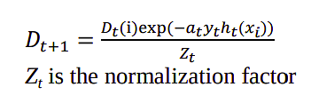


Adaboost Algorithm cont.
Base learner H(t) error is computed as follows.
Where E(t) is the error of the individual classifier.
The wrongly classified records are given higher weights, and Normalizations is done such that the sum of the weights =1.
Ensemble Classifier weighted output is computed as follows.
.^ coef -> Element-wise power of coef, best = 1.2
Sign is Signum function {-1,0,1}

Slide 5
Visualization of Adaboost
A single weak classifier.
Model 1
Model 2
Model 3
Model N
Weight 1
Weight 2
Weight 3
Weight N-1
Weight N
Multiple Weak Classifier for base learner.
Weak classifier 1
Weak classifier 2
Weak classifier k
Combiner
Dataset
Weak classifier 1
Weak classifier 2
Weak classifier k
Class Label
Weak classifier 1
Weak classifier 2
Weak classifier k

Slide 6
Results
The performance of the best model is evaluated by 3 metrics .
Sensitivity = TP/(TP+FN).
Specificity = TN/(TP+FP).
Accuracy = TP+TN/(TP+FN+TP+FP).
Adaboost-SVM is more stable for the “Wisconsin Breast cancer” & “Pima Diabetes”.
Adaboost-Decision Tree is more stable for “Liver Disorder Dataset”.
# of base learner is important parameter which affects the performance of the classifier.
 | Adaboost -SVM |  | Adaboost -Decision Tree
Dataset | # Base learner | Accuracy (%) | # Base learner | Accuracy (%)
Wisconsin Breast Cancer | 12 | 97 | 12 | 96
Pima Diabetes | 4 | 77 | 24 | 68
Liver Disorder | 16 | 65 | 12 | 65

Slide 7
Use in our Project
We can use the similar idea for multiclass-classification, by using the Ensemble technique using several classification algorithm to find best Classifier.
SVM | DT | LR | RF | KNN | NB
ADABOOST Algorithm
Our-Dataset
Best Classification Algorithm
DATA | # of Patterns ( samples) | # of Features. (Attributes)
SIGABA ( 1-10 ) settings | 10^5 * 10 = 10^6 | 8
Hill-Cipher | 100000 | 8
Enigma | 100000 | 8

